Slide 1
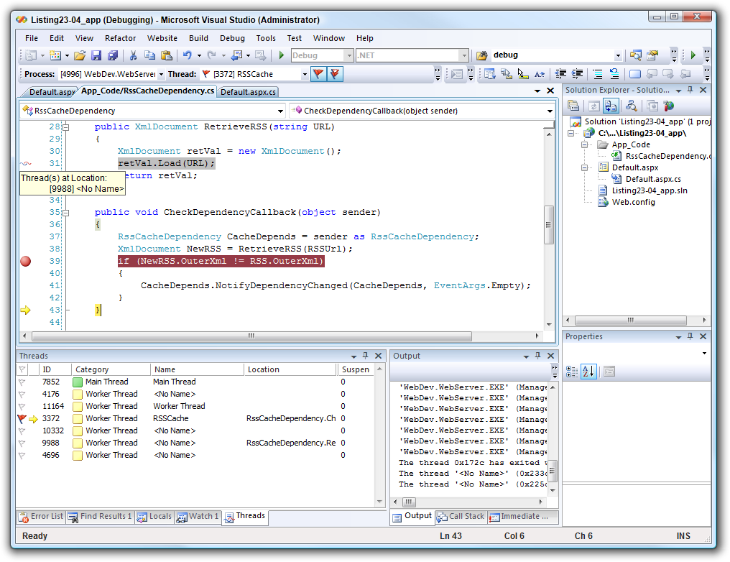

Debugging
Building Rock-Solid Software
SoftUni Team
Technical Trainers
Software University
https://softuni.bg

Slide 2
Table of Contents
Introduction to Debugging
Visual Studio Debugger
Breakpoints
Data Inspection
Threads and Stacks
Finding a Defect

Slide 3
Have a Question?
sli.do
#csharp-advanced

Slide 4

Introduction to Debugging

Slide 5
What is Debugging?
The process of locating and fixing or bypassing bugs (errors) in computer program code
To debug a program:
Start with a problem
Isolate the source of the problem
Fix it
Debugging tools (called debuggers) help identify coding errors at various development stages

Slide 6
Debugging vs. Testing
Testing
A means of initial detection of errors
The process of verifying and validating that a software or application is bug free
Debugging
A means of diagnosing and correcting the root causes of errors that have already been detected
The process of identifying, analyzing and fixing a bug in the software
Notes:
Some programmers use the terms "testing" and "debugging" interchangeably, but careful programmers distinguish between the two activities.
Testing is a means of detecting errors. Debugging is a means of diagnosing and correcting the root causes of errors that have already been detected.

Slide 7
Importance of Debugging
$60 Billion per year in economic losses due to software defects
E.g. the Cluster spacecraft failure was caused by a bug
Perfect code is an illusion
There are factors that are out of our control
Legacy code
You should be able to debug code that is written years ago
Deeper understanding of system as a whole

Slide 8
Debugging Philosophy
Debugging can be viewed as one big decision tree
Individual nodes represent theories
Leaf nodes represent possible root causes
Traversal of tree boils down to process state inspection
Minimizing time to resolution is key
Careful traversal of the decision tree
Pattern recognition
Visualization and ease of use helps minimize time to resolution

Slide 9
Example Debugging – Decision Tree
Exception
FileNotFound
Wrong Input
Null Reference
Wrong Path
Wrong Symbols
Missing "@"
Single "/"

Slide 10

Visual Studio Debugger

Slide 11
Visual Studio Debugger
Visual Studio IDE gives us a lot of tools to debug your application
Adding breakpoints
Visualize the program flow
Control the flow of execution
Data tips
Watch variables
Debugging multithreaded programs
And many more…

Slide 12
Debugging a Solution
Debug menu, Start Debugging item
F5 is a shortcut
Easier access to the source code and symbols since its loaded in the solution
Certain differences exist in comparison to debugging an already running process
Hosting for an ASP.NET application
Visual Studio uses a replacement of the real IIS

Slide 13
Debug Windows
Debug Windows are the means to introspect on the state of a process
Opens a new window with the selected information in it
Window categories
Data inspection
Threading
Accessible from menu
Debug -> Windows

Slide 14
Debugging Toolbar
Convenient shortcut to common debugging tasks
Step into
Step over
Continue
Break
Breakpoints
Customizable to fit your needs
Add / Remove buttons

Slide 15
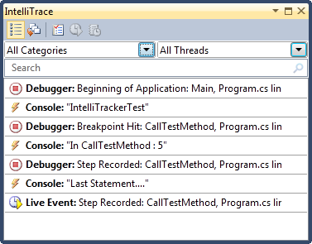
IntelliTrace
IntelliTrace operates in the background, records what you are doing during debugging
You can easily get a past state of your application from IntelliTrace
You can navigate through your code and see what's happened
To navigate, just click any of the events that you want to explore

Slide 16

Breakpoints

Slide 17
Breakpoints
Ability to stop execution based on certain criteria is key when debugging
When a function is hit
When data changes
When a specific thread hits a function
Much more…
Visual Studio's debugger has a huge feature set when it comes to breakpoints

Slide 18
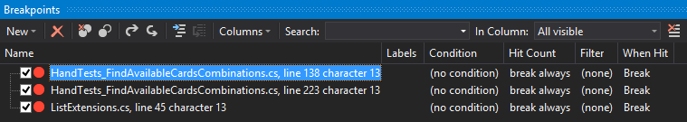
Managing Breakpoints
Managed in the breakpoint window
Adding breakpoints
Removing or disabling breakpoints
Labeling or grouping breakpoints
Export/import breakpoints

Slide 19

Data Inspection

Slide 20
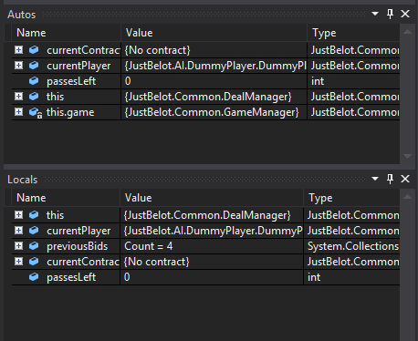
Visual Studio Data Inspection
Visual Studio offers great data inspection features
Watch windows
Autos and Locals
Memory and Registers
Data Tips
Immediate window

Slide 21
Watch Window
Allows you to inspect various states of your application
Several different kinds of "predefined" watch windows
Autos
Locals
"Custom" watch windows also possible
Contains only variables that you choose to add
Right click on the variable and select "Add to Watch"

Slide 22
Autos and Locals
Locals watch window contains the local variables for the specific stack frame
Debug -> Windows -> Locals
Displays: name of the variable, value and type
Allows drill down into objects by clicking on the + sign in the tree control
Autos lets the debugger decide which variables to show in the window
Loosely based on the current and previous statement

Slide 23
Memory and Registers
Memory window can be used to inspect process wide memory
Address field can be a raw pointer or an expression
Drag and drop a variable from the source window
Number of columns displayed can be configured
Data format can be configured
Registers window can be used to inspect processor registers

Slide 24
Data Tips
Provides information about variables
Variables must be within scope of current execution
Place mouse pointer over any variable
Variables can be expanded by using the + sign
Pinning the data tip causes it to always stay open
Comments can be added to data tips
Data tips support drag and drop
Importing and exporting data tips

Slide 25
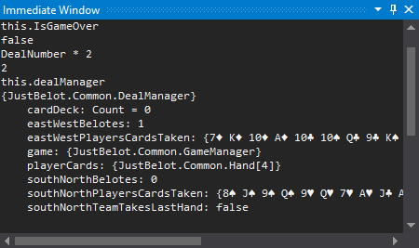
Immediate Window
Useful when debugging due to the expansive expressions that can be executed
To output the value of a variable {name of variable}
To set values, use {name of variable}={value}
To call a method, use {name of variable}. <method>(arguments)
Similar to regular code
Supports IntelliSense

Slide 26

Threads and Stacks

Slide 27
Threads
Fundamental units of code execution
Commonly, programs use more than one thread
In .NET, there is always more than one thread
Each thread has a memory area associated with it known as a stack
Stores local variables
Stores frame specific information
Memory area employs last in first out semantics

Slide 28
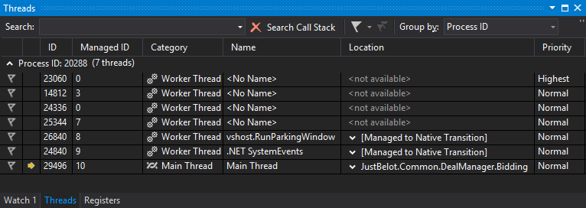
Threads Window
Contains an overview of thread activity in the process
Includes basic information in a per thread basis
Thread ID's
Category
Name
Location
Priority

Slide 29
Breakpoint Filters
Allows you to excerpt even more control of when a breakpoint hits
Examples of customization
Machine name
Process ID
Process name
Thread ID
Thread name
Multiple can be combined using &, ||, !
29

Slide 30
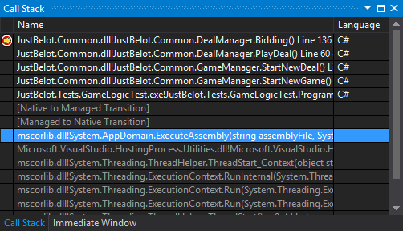
Call Stacks
Visual Studio shows the elements of a call stack
Local variables
Method frames
30

Slide 31

Finding a Defect

Slide 32
Tips for Finding Defects (1)
Use all available data
Refine the test cases
Check unit tests
Use available tools
Reproduce the error in several different ways
Generate more data to generate more hypotheses
Use the results of negative tests
Brainstorm for possible hypotheses
32

Slide 33
Tips for Finding Defects (2)
Narrow the suspicious region of the code
Be suspicious of classes and routines that have had defects before
Check code that's changed recently
Expand the suspicious region of the code
Integrate incrementally
Check for common defects
Talk to someone else about the problem
Take a break from the problem
33

Slide 34
Fixing a Defect
Understand the problem before you fix it
Understand the program, not just the problem
Confirm the defect diagnosis
Relax
Save the original source code
Fix the problem, not the symptom
Make one change at a time
Add a unit test that expose the defect
Look for similar defects
34

Slide 35

Summary
…
…
…
Introduction to Debugging
Visual Studio Debugger
Breakpoints
Data Inspection
Locals, Autos, Watch
Finding a Defect

Slide 36
Questions?
Notes:
36

Slide 37














SoftUni Diamond Partners

Slide 38

Educational Partners

Slide 39
Trainings @ Software University (SoftUni)
Software University – High-Quality Education, Profession and Job for Software Developers
softuni.bg, about.softuni.bg
Software University Foundation
softuni.foundation
Software University @ Facebook
facebook.com/SoftwareUniversity
Software University Forums
forum.softuni.bg
39
Notes:
39

Slide 40

License
This course (slides, examples, demos, exercises, homework, documents, videos and other assets) is copyrighted content
Unauthorized copy, reproduction or use is illegal
© SoftUni – https://about.softuni.bg
© Software University – https://softuni.bg
Notes:
40

